Slide 1

SOEN 6611 Software Measurement -By Team C

Slide 2
Content
Projects: Overview
Metrics
Metric-wise analysis of projects
Correlation among the metrics
Conclusion

Slide 3
Projects Selected: Overview
S.No | Project Name | Size of the project
1 | Apache Commons Math | 186K LOC
2 | JFreeChart | 317K LOC
3
4

Slide 4
Metric calculations
Metric 1 Statement coverage: (Number of statements executed/Total number of statements) *100
Metric 2 Branch Coverage: (Number of branches executed/Total number of branches) *100
Metric3: Test Suite Effectiveness Mutation Score: (Number of mutants killed/Total number of mutants) * 100

Slide 5
Metric calculations
Metric 4 McCabe’s Cyclomatic Complexity: measure of linearly independent paths for a program is.
M = E - N + 2P. where, E-Number of edges in the graph N-Number of Nodes in the graph P-Number of connected components.
Metric 5 Code Churn : measure of changes made in the lines of code. Total lines modified = Total lines added in previous version + total lines altered.Code Churn = Total lines modified/total number of lines(LOC)
Metric 6 Post Release Defect Density: Code smells are a set of common signs which indicate that code is not good enough and it needs refactoring.
God class: a class that has grown too large.
Feature envy : a class that uses methods of another class excessively and it resulted in high coupling which is against the design quality.
Long method : A method contains too many lines of code. Generally, any method longer than ten lines should make you start asking questions.

Slide 6
Metric-Wise Analysis of projects
Project | Size | Code Coverage | Branch Coverage | Mutation Score | Average Complexity | Maintainability Index | Post-release Defect Density (for latest version)
Apache Commons Math | 186K LOC | 92% | 86% | 79% | 18 | 60.56 | 0.00006225
Apache Commons Lang | 90.7K LOC | 95% | 91% | 86% | 33 | 52.44 | 0.00005125
JFreeChart | 317K LOC | 54% | 46% | 33% | 34 | 56.04 | 0.00008947
Apache Commons dbUtils | 10.2K LOC | 64% | 77% | 51% | 11 | 70.23 | 0.000582
Apache Commons Collections | 132K LOC | 86% | 81% | 42% | 15 | 76.29 | 0.0000159

Slide 7
Correlations: Code coverage and test suite effectiveness (Metric 1,2 & 3)
In the 5 open source projects we have noticed that:
“With Higher code coverage, we have achieved a better test suite effectiveness”
Tools used to calculate:
Jacoco (EclEmma) to calculate the statement and branch coverage (Metric 1&2)
PITClipse and Pit Mutant Plugin to perform PIT testing to get the test suite effectiveness (Metric 3)
https://www.wessa.net/rwasp_spearman.wasp#output is the tool we have used for calculating Spearsman correlation coffiecient

Slide 8
Spearman Correlation Coefficient
Project | Spearman Correlation Coefficient between Mutation Score and Statement Coverage
JFreeChart | 0.841

Slide 9
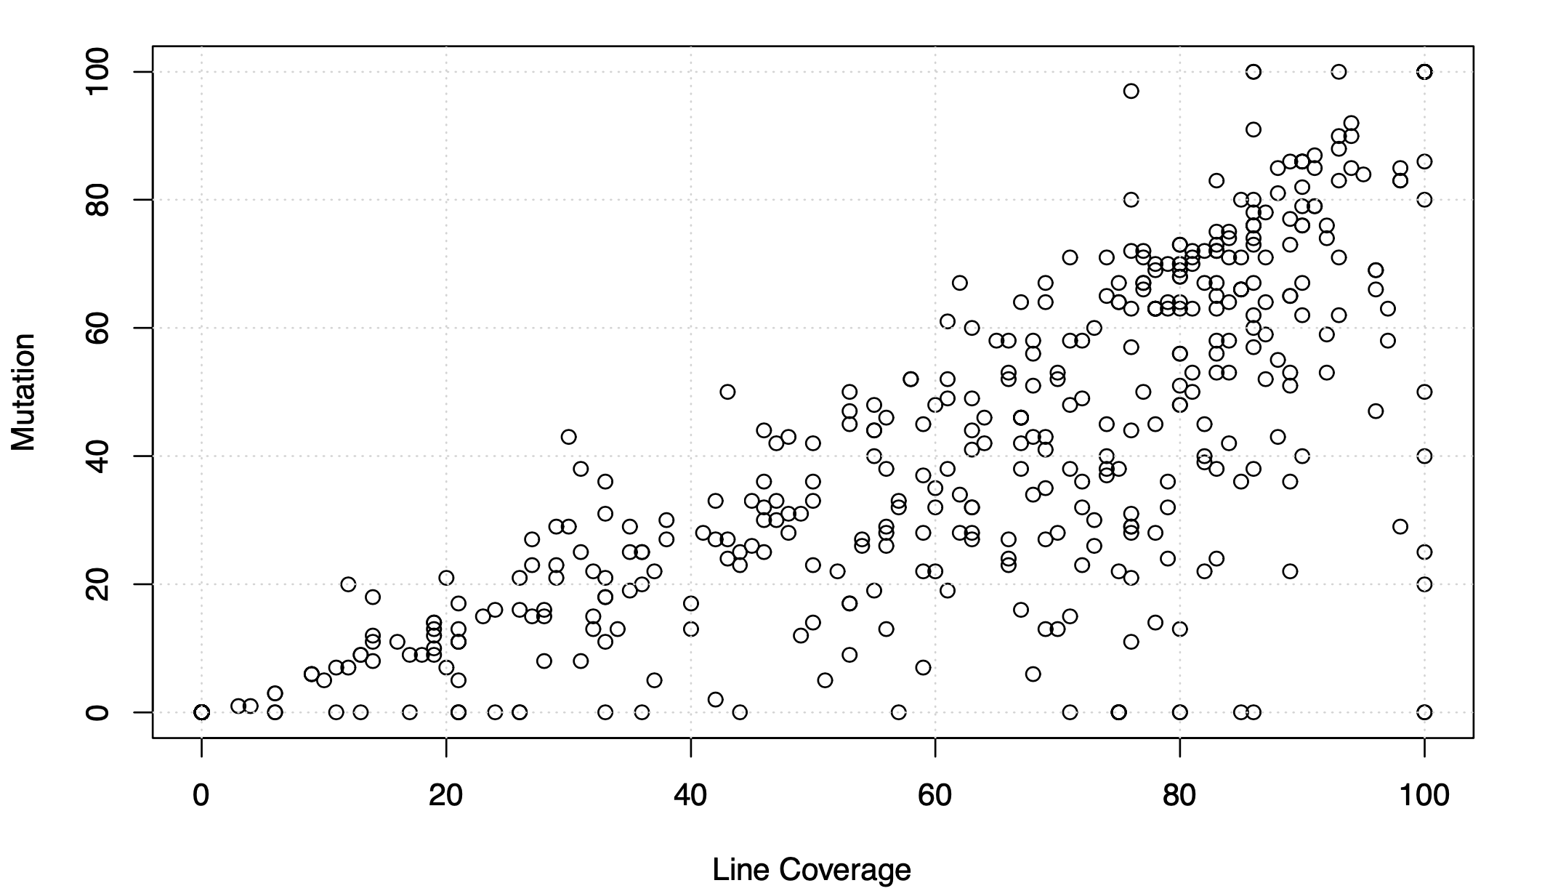
Jfree Chart

Slide 10
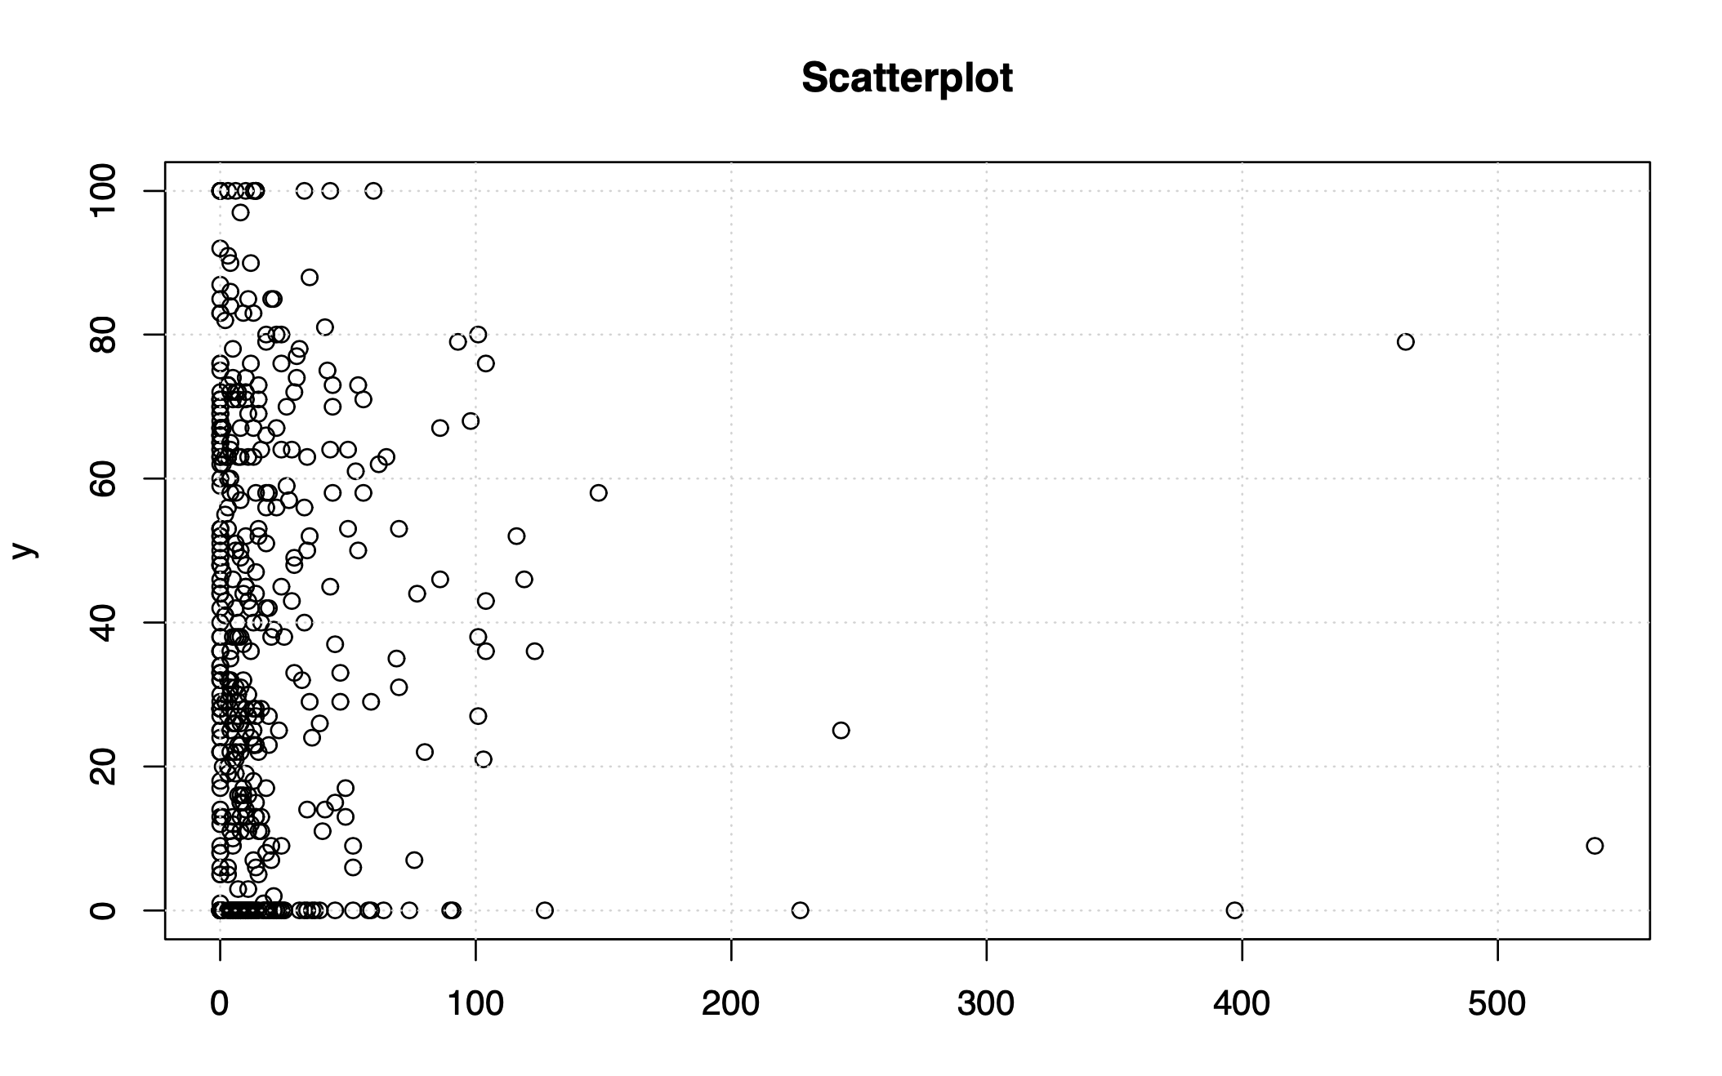
Jfree Chart
Branch Coverage

Slide 11
Correlations: Code coverage and code complexity (Metric 1,2 & 4)
“Classes with higher complexity are less likely to have high coverage test suites”
Tools used to calculate:
Jacoco (EclEmma) to calculate the statement and branch coverage and cyclomatic complexity (Metric 1-4)
Measurement of Spearman correlation is done referring to the url given below : https://www.wessa.net/rwasp_spearman.wasp#output

Slide 12
Correlation between 1-2 & 4
Project | Spearman Correlation (1&4) | Spearman Correlation (2&4)
JFreeChart | 0.951 | 0.934

Slide 13
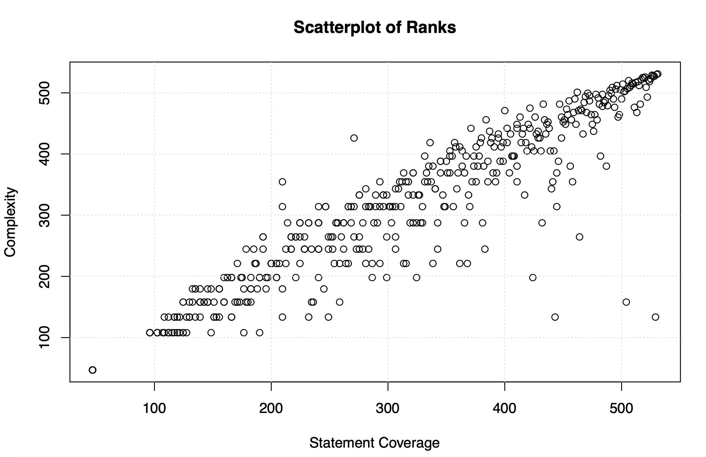

Slide 14
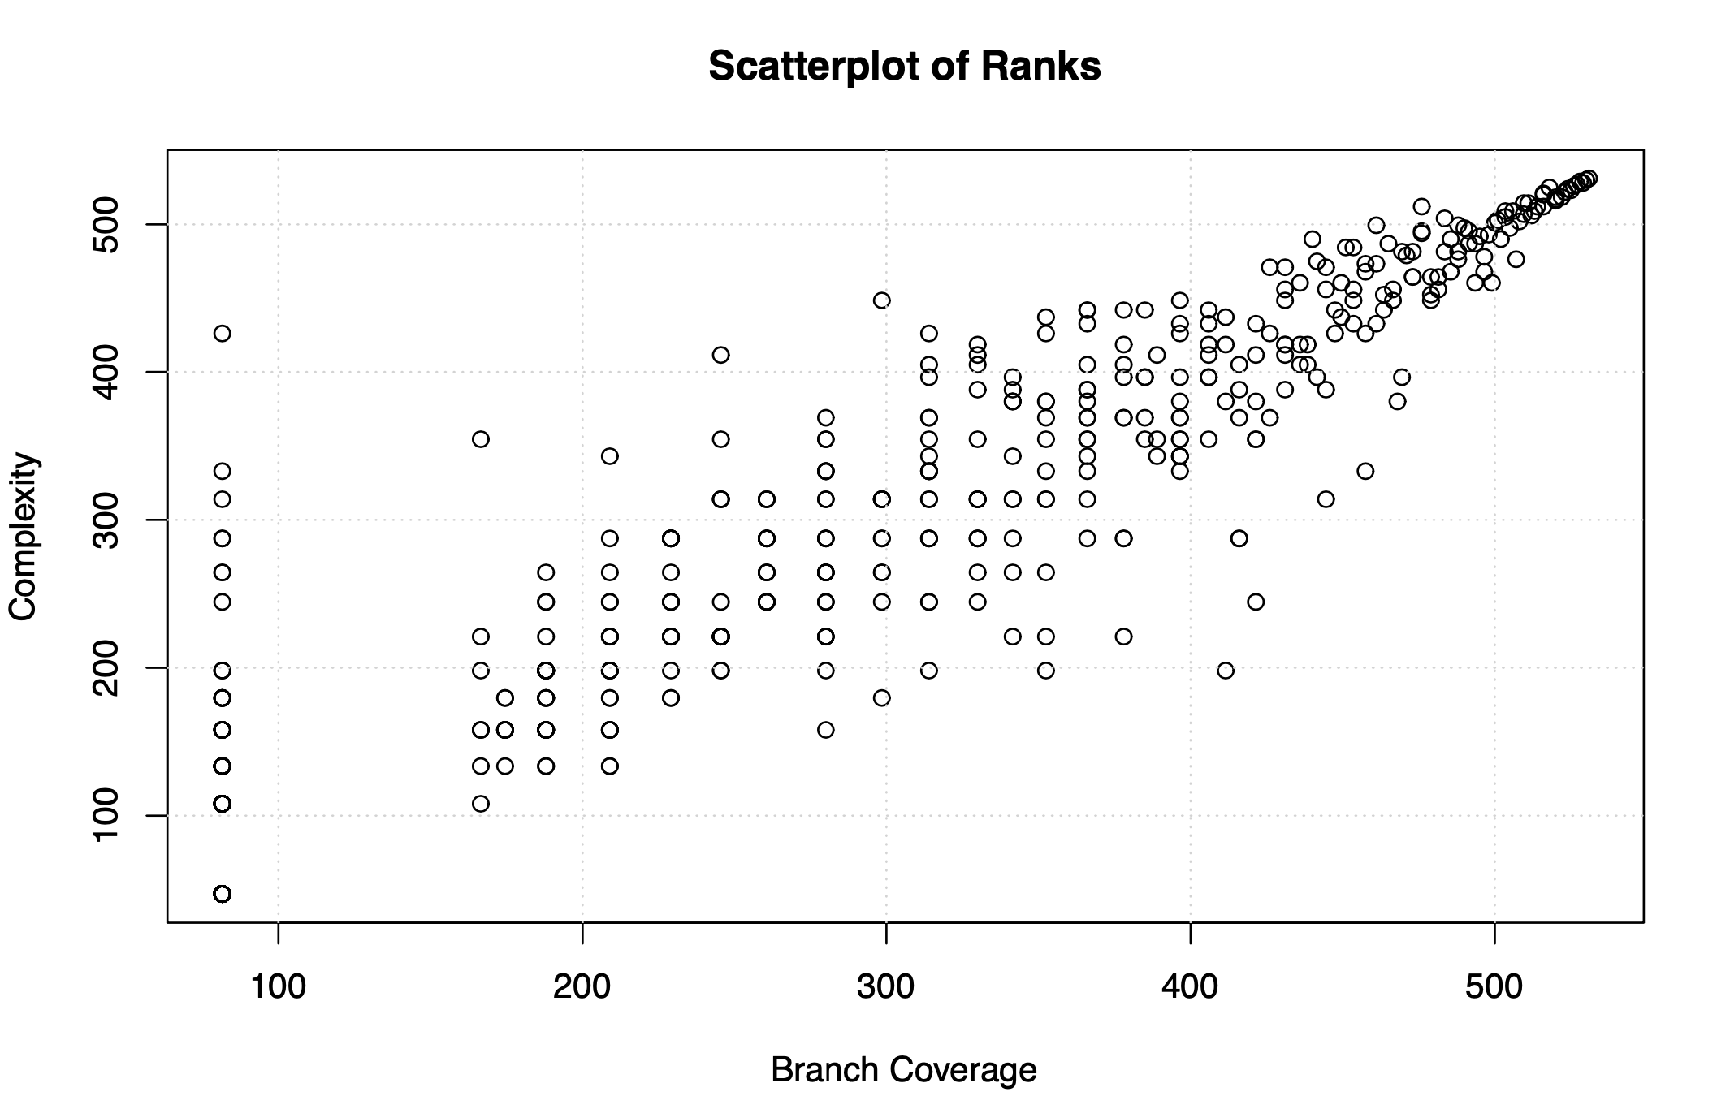

Slide 15
Correlations: Code coverage and Code Smells (Metric 1,2 & 6)
“Classes with low test coverage contain more bugs”.
Tools used to calculate:
Jacoco plugin in IntelliJ to calculate the statement and branch coverage (Metric 1&2)
Jdeodorant (Eclipse plugin ) to calculate different types of code smells in a project.

Slide 16
Correlation between 1-2 & 6
Project | Spearman Correlation (1&6) | Spearman Correlation (2&6)
JFreeChart | -0.99 | -0.782

Slide 17
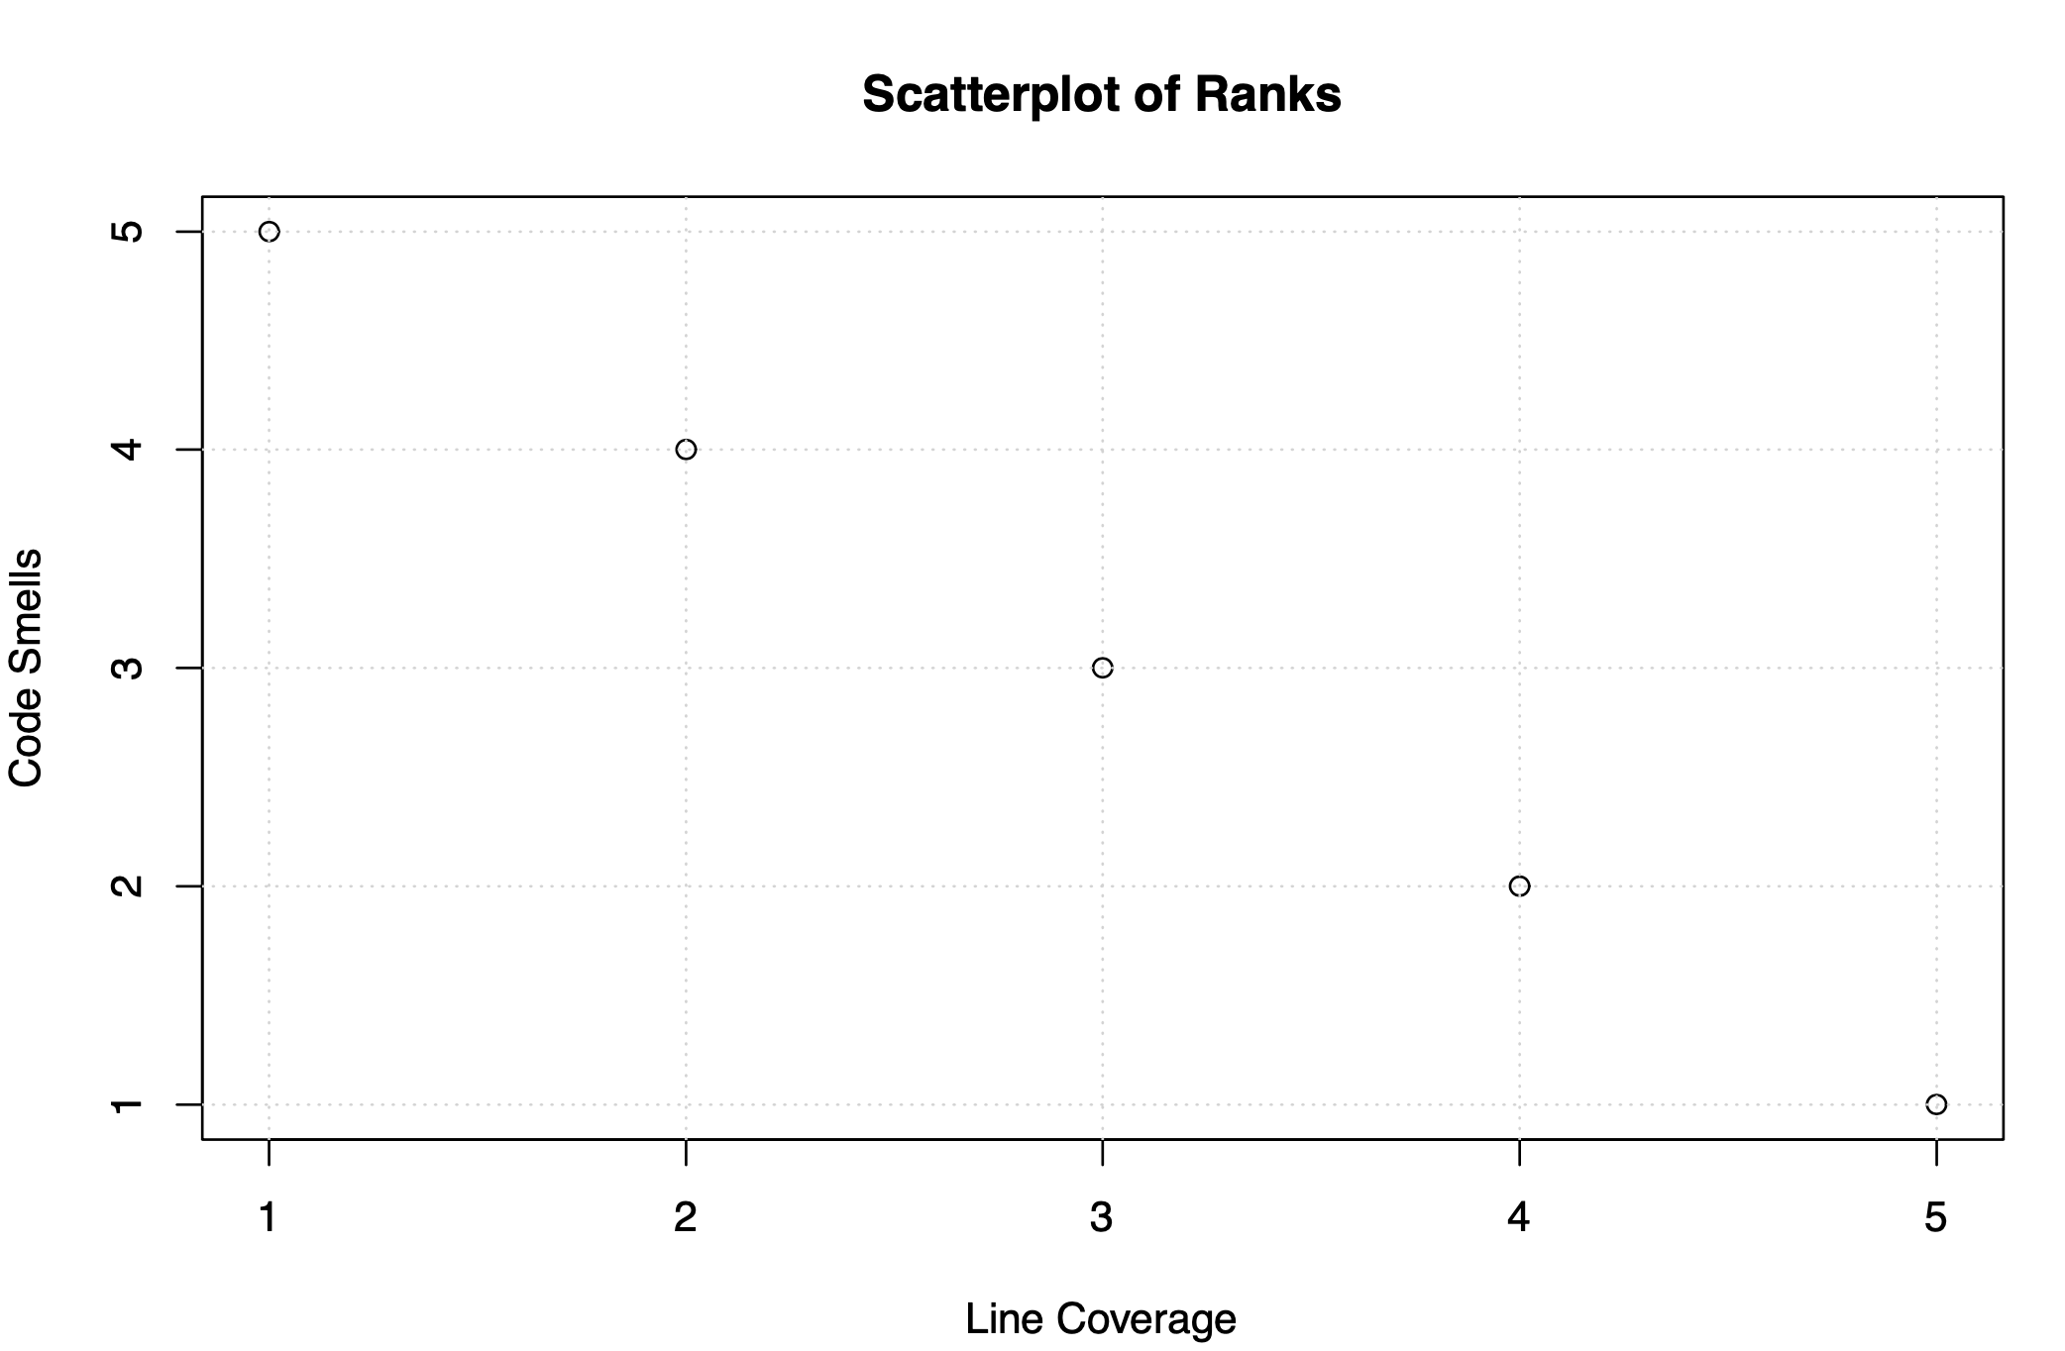
Jfree Chart

Slide 18
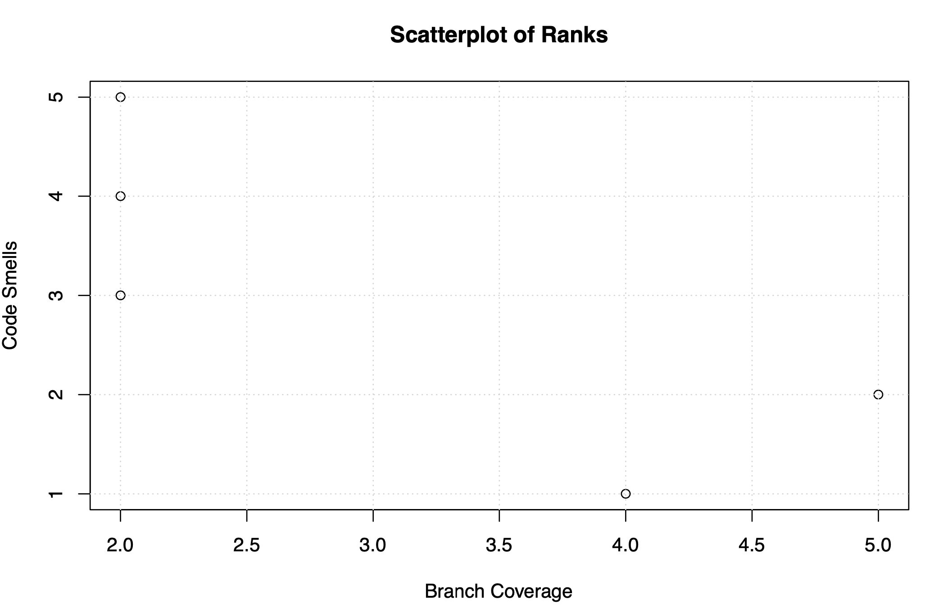
Jfree Chart

Slide 19
Correlations: Code Churn and Code Smells (Metric 5 & 6)
“Higher the maintainability index results in less number of post release defects”
Tools used to calculate:
Use of Prest for Halstead volume and Sci-tools for cyclomatic complexity & SLOC
JIRA and BugZilla as issue trackers to get the bug reports for projects as all the projects use this as their issue tracking system.
We use JIRA and BugZilla GUI for finding the bugs from this issue trackers over all the other ways e.g. Using their API

Slide 20
Correlation between 5 & 6
Project | Spearman Correlation (5&6)
JFreeChart | -1

Slide 21
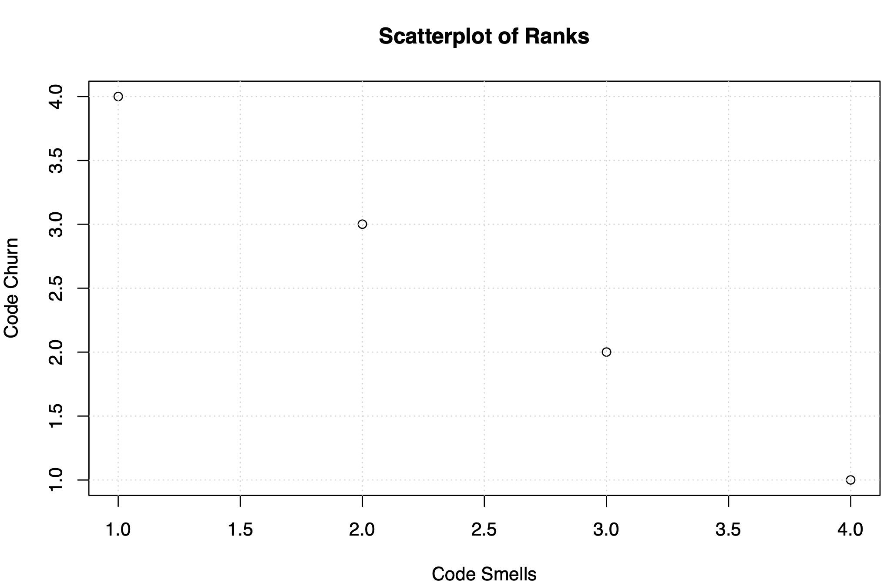
Jfree Chart

Slide 22
Observations
Higher code coverage ensures the efficiency of the project and also has a correlation with complexity.
Testing the effectiveness of the test suite largely depends on expertise of test professionals, technologies and test automation used. Test suite effectiveness is high if all the mutations in the class are killed.
Though statement coverage ensures efficiency of the test suite it doesn’t confirm that source code is error free.
Having a better/higher maintainability index ensures less software maintenance costs. However, it might not always ensure a bug free system.

Slide 23
Thanking you
Submitted By: Team C
Name | Student ID | Email
Karan Sharma | 40080005 | 95sharma.karan@gmail.com

